Slide 1
Tech-Driven Solutions for Undertrial Prisoners in India
PIP2001 Capstone Project
Review-0
Batch Number:33
Roll Number | Student Name
20211CSE0112 20211CSE0114 20211CSE0125 | Kasturi Deepak Reddy Masu Teja Darisi Phani Bala Jaswanth
20211CSE0122 | Yaganti Praveen
Under the Supervision of,
Ms . Rohini A.
Assistant Professor
School of Computer Science and Engineering
Presidency University
Name of the Program: CSE
Name of the HoD: Dr. Asif Mohammed H.B
Name of the Program Project Coordinator: Mr. Amarnath J.L
Name of the School Project Coordinators: : Mr. Md Ziaur Rahman

Slide 2
Content
Problem Statement
Github Link
Analysis of Problem Statement
Timeline of the Project
References

Slide 3
Problem Statement Number:
Organization: Ministry of Law and Justice
Category (Hardware / Software / Both) :Software
Problem Description : Undertrial prisoners in India face significant challenges, including limited legal aid, lack of access to court proceedings, and delayed justice. Many remain incarcerated due to a lack of legal representation or resources. This project aims to develop technology-driven solutions to bridge the gap, ensuring timely legal support and rehabilitation opportunities.
Difficulty Level: Complex

Slide 4
Github Link
The Github link provided should have public access permission.
Github Link
https://github.com/Tech-Solutions-for

Slide 5
Analysis of Problem Statement
Technology Stack Components:
Frontend: (React.js / Angular / Flutter)
Backend: Spring Boot
Database: MySQL
Cloud Services: (AWS / Google Cloud)
Software and Hardware Requirements:
Software: Web and Mobile App Development tools, API integration for legal databases

Slide 6
Analysis of Problem Statement (contd...)
Proposed Solutions & Key Features
Mobile App for Legal Aid – Provides legal representation, access to case updates, and legal resources.
Legal Aid Platform – Connects undertrial prisoners with pro bono lawyers and legal aid organizations.
Rehabilitation Program – Uses technology for education, vocational training, and mental health support.
Dashboard for Case Tracking – Offers real-time updates to lawyers, judges, and prison authorities.
Virtual Rights Awareness Platform – Increases awareness of legal rights and case status for undertrial prisoners.

Slide 7
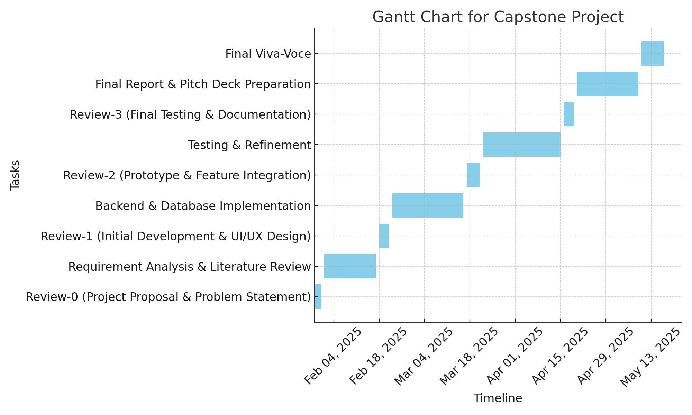
Timeline of the Project (Gantt Chart)

Slide 8
References (IEEE Paper format)
Add APA Citation for all references.
Use the below link for various APA styles :
[1] A. J. Reddy, "Legal aid for undertrial prisoners in India: Challenges and opportunities," International Journal of Law and Policy Studies, vol. 12, no. 3, pp. 45-56, 2023.
[2] S. K. Sharma, "Technology intervention in the Indian judicial system: A case study on digital justice," Journal of Legal Technology, vol. 9, no. 2, pp. 120-135, 2022.
[3] N. Gupta and A. Mehta, "AI-based case tracking system for legal aid in India," in Proceedings of the International Conference on Legal Tech and AI, 2021, pp. 78-89.
[4] Government of India, Prison Statistics India 2022, National Crime Records Bureau, 2023. [Online]. Available: https://ncrb.gov.in
[5] M. Verma, "Access to justice through digital platforms: A new era of legal aid in India," Indian Journal of Law and Society, vol. 10, no. 1, pp. 33-47, 2022.

Slide 9


